Slide 1
The UnderFrogs
ENTERPRISE TRADING PLATFORM · PROGRESS SHOWCASE
What we've built so far: sprints 3 to 8
Marco Nocerino · David Jayakumar · Shane Ginty · Jamie Montgomery
[date]
Notes:
[Speaker 1] ~15 seconds. "Hi, we're the UnderFrogs. Over the last seven weeks we've built an enterprise trading platform, one sprint at a time. We'll show you what we built, then place a real trade live."

Slide 2
Agenda
01
Who we are
02
What we built
Team, timeline, how we work
Architecture, data model, live and batch data
03
How a trade works
04
Security and quality
Order lifecycle over Kafka, then a live demo
JWKS auth, testing, the CI pipeline
05
Lessons learned
06
What's next
Decisions we'd make again
Angular, our extension, AWS
The UnderFrogs · 02
Notes:
[Speaker 1] ~10 seconds. Don't read every line. "We'll cover who we are, what we built, then show a trade go through live, how we secured and tested it, and what's next."

Slide 3
Four developers, seven weeks, one platform
01 · WHO WE ARE
4
7 wks
640
136
developers
20 Aug to 7 Oct
commits
merged pull requests
How we work
GitFlow
feature → develop → main
Jira sprints
stories, points, owners
Reviewed PRs
no direct pushes to develop
Tests first
pin behaviour before refactors
The UnderFrogs · 03
Notes:
[Speaker 1] ~35 seconds. Introduce each person by name and what they mainly owned: [Marco: ...], [David: ...], [Shane: ...], [Jamie: ...]. Then: "We worked in GitFlow with Jira sprints. Everything went through a reviewed pull request: 136 of them in seven weeks."

Slide 4
Seven services, one event backbone
02 · WHAT WE BUILT
Client: curl and Swagger today · Angular UI next sprint
auth-service
accounts
instruments
orders
positions
NestJS · issues JWTs
Spring Boot · cash
Spring Boot · prices
Spring Boot · places
Spring Boot · holdings
Kafka
orders · trade-events · market-data · + dead-letter topics
trade-executor
trade-analytics-service
Dashboard
Java · prices and settles orders
Python · ETL into a star schema
Python Dash · live and batch views
6 Postgres databases, one per service · everything runs in Docker Compose · kafka-ui and SonarQube alongside
The UnderFrogs · 04
Notes:
[Speaker 1] ~75 seconds. Walk top to bottom. "Requests come in to four Spring Boot services. Each one owns its own database: no service reaches into another's tables. auth-service, in NestJS, is the only thing that issues tokens. When an order is placed it goes onto Kafka, and the trade-executor picks it up and executes it asynchronously. Kafka also feeds the analytics side: a Python ETL into a star schema, and a dashboard. All of it starts with one setup script in Docker Compose."

Slide 5
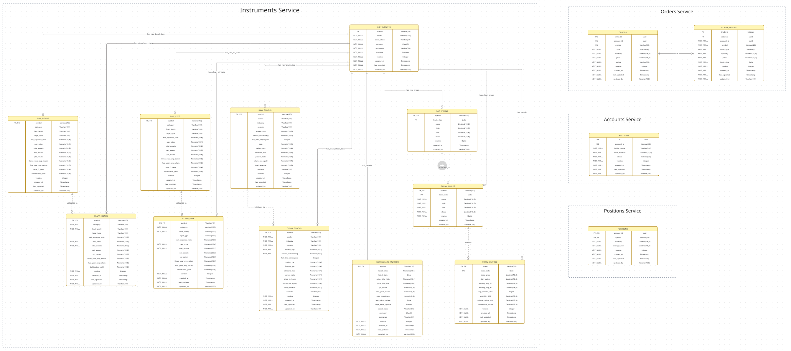
Data model: one database per service
02 · WHAT WE BUILT
6 Postgres databases
Each service owns its data. No cross-service joins.
Raw → clean
Instrument data lands raw, then is validated into clean tables.
Safe concurrent writes
Version columns for optimistic locking. Unique idempotency keys.
Ledgers for audit
cash_movements and position_movements record every change.
ERD: instruments, orders, accounts and positions databases
The UnderFrogs · 05
Notes:
[Speaker 2] ~45 seconds. Don't try to read the ERD: it's there to show scale. "We split the original single database so every service owns its own data. Instrument data from yfinance lands in raw tables and is validated into clean ones. Every table that can be updated concurrently has a version column for optimistic locking, and orders have a unique idempotency key, which is what stops a double charge. Cash and position changes are written to ledgers, so every balance can be traced."

Slide 6
Live and batch: two lanes for data
02 · WHAT WE BUILT
 | ● Live (streaming) | ■ Batch (ETL)
Source | Alpaca quotes, order events | Order databases, yfinance history
Moves via | Kafka: market-data, orders, trade-events | Python ETL jobs
How often | Within seconds | Every 5 minutes, incremental
Lands in | Executor, dashboard Live tab | Star schema: fact_trades + 3 dimensions
Safety net | Dead-letter topics, retries | Watermark, dead-letter table, retries
Answers | "What's happening right now?" | "What's the trend?"
Live for operations, batch for reporting, and analytics never puts load on the trading databases.
The UnderFrogs · 06
Notes:
[Speaker 2] ~75 seconds. "Data moves through the platform in two lanes. The live lane is Kafka: the trade-executor polls quotes from Alpaca, or the daily close as a fallback, and publishes them on market-data; order events go on orders and trade-events. The dashboard's Live tab consumes those and refreshes every two seconds. The batch lane is Python ETL: at setup it loads instruments and prices, and every five minutes trade-analytics-service picks up new orders since its last watermark and loads them into a star schema. Bad rows go to a dead-letter table rather than breaking the run. Live answers what's happening now; batch answers what the trend is." You'll prove both in the demo.

Slide 7

One order, start to finish, over Kafka
03 · HOW A TRADE WORKS
1
2
3
4
5
Place
Publish
Price
Settle
Notify
orders-service validates, saves the order as NEW, replies 201
ORDER_PLACED goes on the orders topic, keyed by account
trade-executor gets a quote and decides: fill or reject
Saga: debit cash, update position, mark FILLED. Reverses if a step fails
ORDER_FILLED on trade-events feeds the dashboard and analytics
What keeps it safe
Idempotency keys: a resent order is never charged twice
Dead-letter topics: failed messages are retried, then parked
Guarded cancel: a filled order can't be cancelled
Optimistic locking: two updates can't overwrite each other
The UnderFrogs · 07
Notes:
[Speaker 3] ~75 seconds. "Originally, placing an order did everything inside one HTTP request. Now the request only validates and saves the order as NEW, then returns straight away. The order goes onto Kafka, the trade-executor prices it, and a settlement saga debits cash and updates the position. If any step fails, the earlier steps are reversed, so we never end up with cash taken but no shares. Because messages can be delivered twice, every write is idempotent, and anything that keeps failing lands in a dead-letter topic instead of being lost." Then: "Let's show you." Hand over to the demo.

Slide 8
Let's place a trade
▶ LIVE DEMO
1 Log in through auth-service
5 Order FILLED, cash down, position up
2 Call without a token: 401
6 Resend the same order: no double charge
3 Place a BUY: it returns NEW
7 See it on the dashboard: live, then batch
4 Watch the events in kafka-ui
The UnderFrogs · 08
Notes:
[Speaker 3 drives, Speaker 4 narrates] ~5.5 minutes. Leave this slide up while switching to the terminal. Before presenting: stack running (./db/scripts/setup-pipeline.sh), ETL_INTERVAL_SECONDS set to ~30, tabs open for terminal, kafka-ui :8086 (trade-events), auth Swagger :8087/docs, dashboard :8085. 1. POST :8087/auth/login with a seed user → copy the token. Optionally open :8087/.well-known/jwks.json: "the only key the other services trust." 2. GET :8083/api/orders/[id] with no token → 401. 3. POST :8083/api/orders with accountId, symbol, side BUY, quantity, priceLimit, idempotencyKey → 201 with status NEW. "It returns straight away: execution is asynchronous." 4. kafka-ui: ORDER_PLACED on orders, then ORDER_FILLED on trade-events with the fill price. 5. GET the order → FILLED. GET :8081/api/accounts/[id] → cash went down. GET :8084/api/positions/[id]/[symbol] → new position. 6. Send the exact same request again, same idempotency key → no second charge. [Rehearse: say exactly what the response is.] 7. Dashboard Live tab shows the trade within seconds; trade analytics shows it after the next ETL run. Backup: if anything fails, play the recorded video. Don't debug live.

Slide 9
Security: one service issues every token
04 · SECURITY AND QUALITY
BEFORE
AFTER · SPRINT 8
accounts-service handled users and login
One shared secret copied into every service
Any service holding it could create a valid token
NestJS auth-service owns users and logins
argon2id password hashing; old BCrypt hashes upgraded at next login
RS256 tokens: the private key never leaves auth-service
Services verify with its public key (JWKS), checking issuer and audience
Roles map to Spring roles for access control
Finishing this sprint: service tokens for the trade-executor, account ownership checks, OWASP auth review
The UnderFrogs · 09
Notes:
[Speaker 4] ~45 seconds. "Before, every service shared one secret, so any of them could forge a token. Now only auth-service can sign tokens, with a private key it never shares. Every other service downloads the public key from its JWKS endpoint and checks the signature, the issuer and the audience. Passwords are hashed with argon2id, and existing users' old BCrypt hashes are upgraded the next time they log in, so nobody had to reset their password." [Update the "Finishing this sprint" line to match the board on the day.]

Slide 10
Quality: tested and gated on every build
04 · SECURITY AND QUALITY
~670
13
11
Java tests across 5 services
Jest test files for auth-service
pytest files for the ETL pipelines
The Jenkins pipeline
1
2
3
4
5
6
7
Build ×5, in parallel
Unit tests
Python tests
End-to-end smoke test
Dependency analysis
SonarQube scan
Quality gates
The UnderFrogs · 10
Notes:
[Speaker 2] ~45 seconds. "Every push runs through Jenkins: five services built in parallel, unit tests, the Python tests, then an end-to-end smoke test that starts the whole stack, places a real order and checks it settles. Then dependency analysis and SonarQube, and the build fails if a quality gate fails." Mention characterisation tests: "Before each big refactor, like moving orders onto Kafka or auth into NestJS, we first wrote tests that pinned the existing behaviour, so we'd know if we broke anything." If possible, show a screenshot of a green Jenkins stage view here.

Slide 11
Decisions we'd make again
05 · LESSONS LEARNED
Tests before refactors
Execute orders asynchronously over Kafka
Postgres star schema, not Snowflake
WHY
We rebuilt order placement and auth while they were in use. Characterisation tests pinned the old behaviour first.
WHY
WHY
A request shouldn't wait on a broker. Failures retry without losing the order.
The whole stack runs locally in Docker, with no cloud account or cost.
TRADE-OFF
TRADE-OFF
LESSON
More moving parts, so we needed idempotent writes and dead-letter topics.
Same dimensional model, so moving to Snowflake later changes the load step, not the design.
A red test told us exactly what we'd changed, so big refactors stopped being risky.
The UnderFrogs · 11
Notes:
[Speaker 1] ~45 seconds. Pick the story you can tell best for each card, ideally a real moment (a test that caught a bug, a message that landed in a dead-letter topic). [Team: check these reasons match why you actually made each decision, and replace the lesson lines with your own.]

Slide 12
Next: a UI, our extension, and the cloud
06 · WHAT'S NEXT
SPRINT 9
SPRINT 10 · EXTENSION
SPRINT 11
Angular UI
Pre-trade compliance
AWS deployment
Login, dashboard, order ticket, order history
JWT interceptor and route guards
Playwright end-to-end tests
Restricted list and concentration limits
Block or warn, with the reason shown
Every check and override audited
Backup idea: trade surveillance
Angular on S3 behind CloudFront
Private bucket, served only through the CDN
Automated build, upload, invalidate
First: finish Sprint 8 and merge it to develop.
The UnderFrogs · 12
Notes:
[Speaker 1] ~30 seconds. "Next sprint we put an Angular front end on all of this. For our extension we've picked pre-trade compliance: checks that block or warn on risky orders before they reach Kafka, with a full audit trail. Then we deploy to AWS." [Only say the extension is claimed once the instructor has confirmed it.]

Slide 13
Questions?
Thank you from the UnderFrogs
Marco Nocerino · David Jayakumar · Shane Ginty · Jamie Montgomery
Notes:
All speakers. Decide in advance who answers what: data and ETL [name], Kafka and execution [name], auth [name], CI and testing [name]. Likely questions: Why Kafka instead of calling the executor directly? What happens if the executor crashes mid-settlement? Why not Snowflake? How do you stop a duplicate order?

